Slide 1


Slide 2

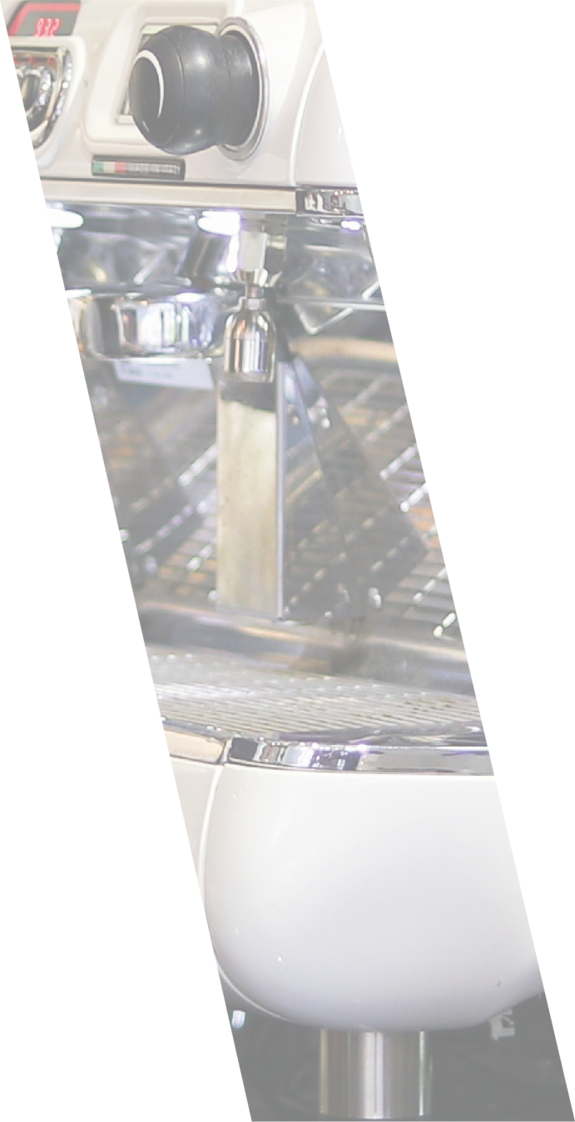
#Rights4AllSeasons
#EU4FairWork
DREPTURI PENTRU TOATE SEZOANELE
Sigură, sezonieră, declarată
Notes:
To change the main image:
Click on the icon to add picture > Select desired image from your folder and confirm.
Once the image has been added, it will need a little adjustment to ensure people are not cut off. To adjust your image RIGHT CLICK and select ‘Format Image’
Tab on the right hand side will open. Select the fourth icon ‘Picture’ > ‘Crop’
In the ‘Crop’ menu, under’ Picture position’ adjust ‘Off set X’ to move you image left or right and ‘Offset Y’ to move your image up or down.
If you need to zoom in on your image, under ‘Picture position’, adjust ‘Width’ and ‘Hight’ – REMEMBER TO ADJUST THE VALUES PROPORTIONALY – DO NOT STRETCH THE IMAGE, SCALE IT
(e.g. if you click on width 5 times, click on height 5 times as well , etc…)
To adjust the middle image:
Click on the icon to add picture > Select desired image from your folder and confirm.
Once the image has been added, it will need a little adjustment to ensure people are not cut off. To adjust your image RIGHT CLICK and select ‘Format Image’
Tab on the right hand side will open. Select the fourth icon ‘Picture’ > ‘Crop’
In the ‘Crop’ menu, under’ Picture position’ adjust ‘Off set X’ to move you image left or right and ‘Offset Y’ to move your image up or down.
ZOOM IN on your image, under ‘Picture position’, adjust ‘Width’ and ‘Hight’
REMEMBER TO ADJUST THE VALUES PROPORTIONALY – DO NOT STRETCH THE IMAGE, SCALE IT
Rule of thumb showed to multiply the value of the original image twice to get the correct outcome.
You will also need to set transparency to this image. To do so click on the image and go to format settings again. Select ‘Picture’ but this time go to ‘Picture Transparency’ ( 3rd from the top)
Set the transparency to 60%
Your poster is now done.
If you are struggling, please view our video tutorial on how to add / edit images here: XX

